Slide 1
AZ-700T00A Module 07: Design and implement private access to Azure Services
Notes:
Design and Implement Private Access to Azure Services (10–15%)
Design and implement Azure Private Link service and Azure Private Endpoint
• create a Private Link service • plan private endpoints
• create private endpoints
• configure access to private endpoints
• integrate Private Link with DNS
• integrate a Private Link service with on-premises clients
Design and implement service endpoints
• create service endpoints
• configure service endpoint policies
• configure service tags
• configure access to service endpoints
Configure VNet integration for dedicated platform as a service (PaaS) services
• configure App Service for regional VNet integration
• configure Azure Kubernetes Service (AKS) for regional VNet integration
• configure clients to access App Service Environment

Slide 2
Design and implement private access to Azure Services
Lesson 01: Explain Virtual Network Service Endpoints
Lesson 02: Define Private Link Services and Private Endpoints
Lesson 03: Integrate Private Endpoint with DNS
Lesson 04: Exercise - Restrict network access to PaaS resources with virtual network service endpoints
Lesson 05: Exercise - Create an Azure Private Endpoint using Azure PowerShell
Lesson 06: Integrate your App Service with Azure Virtual Networks
Notes:
Design and Implement Private Access to Azure Services (10–15%)
Design and implement Azure Private Link service and Azure Private Endpoint
• create a Private Link service
• plan private endpoints
• create private endpoints
• configure access to private endpoints
• integrate Private Link with DNS
• integrate a Private Link service with on-premises clients
Design and implement service endpoints
• create service endpoints
• configure service endpoint policies
• configure service tags
• configure access to service endpoints
Configure VNet integration for dedicated platform as a service (PaaS) services
• configure App Service for regional VNet integration
• configure Azure Kubernetes Service (AKS) for regional VNet integration
• configure clients to access App Service Environment

Slide 3
Lesson 01: Explain Virtual Network Service Endpoints

Slide 4
Explain Virtual Network Service Endpoints overview
What is a Service Endpoint?
Add Service Endpoints to a subnet
Demonstration
Review

Slide 5
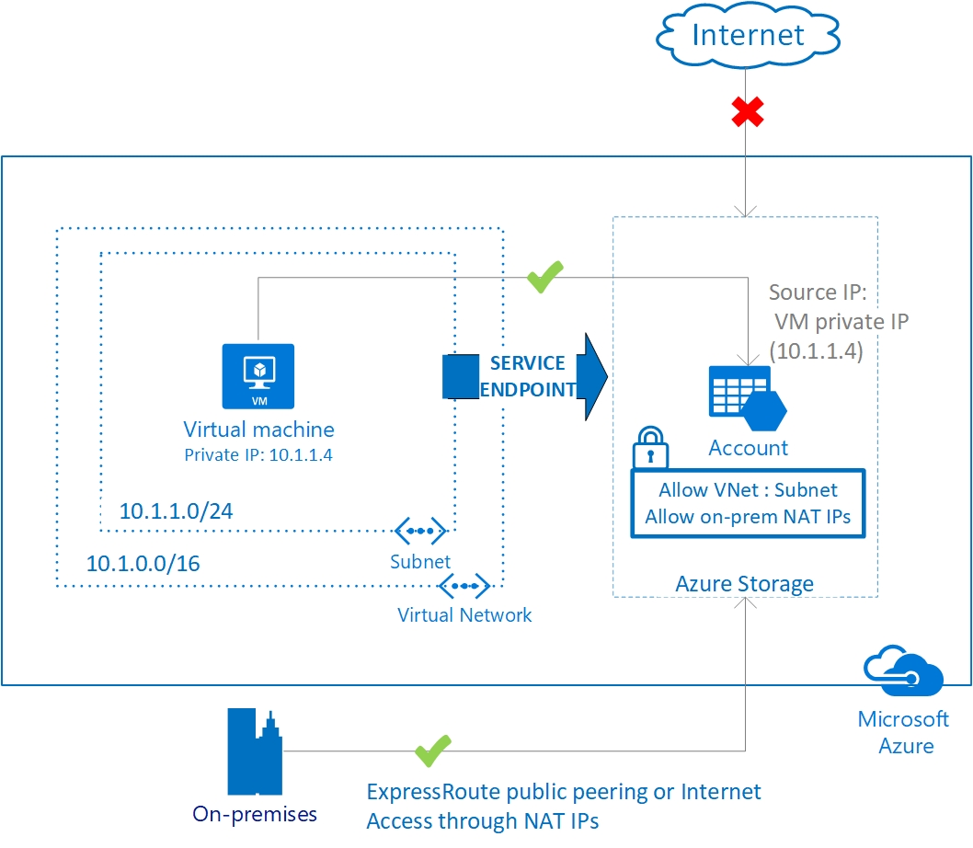
What is Service Endpoint?
Secure and direct connectivity to Azure services over an optimized route over the Azure backbone network
Optimal routing for Azure service traffic from your virtual network
Notes:
Virtual Network (VNet) service endpoint provides secure and direct connectivity to Azure services over an optimized route over the Azure backbone network. Endpoints allow you to secure your critical Azure service resources to only your virtual networks. Service Endpoints enables private IP addresses in the VNet to reach the endpoint of an Azure service without needing a public IP address on the VNet.
Another example using Service Endpoints with SQL Diagram: https://docs.microsoft.com/azure/virtual-network/vnet-integration-for-azure-services#service-endpoints
Virtual network service endpoints - https://docs.microsoft.com/Azure/virtual-network/virtual-network-service-endpoints-overview
Use virtual network Service Endpoints to extend your private address space in Azure by providing a direct connection to your Azure services. Service Endpoints let you secure your Azure resources to only your virtual network. Service traffic will remain on the Azure backbone and doesn't go out to the internet.

Slide 6
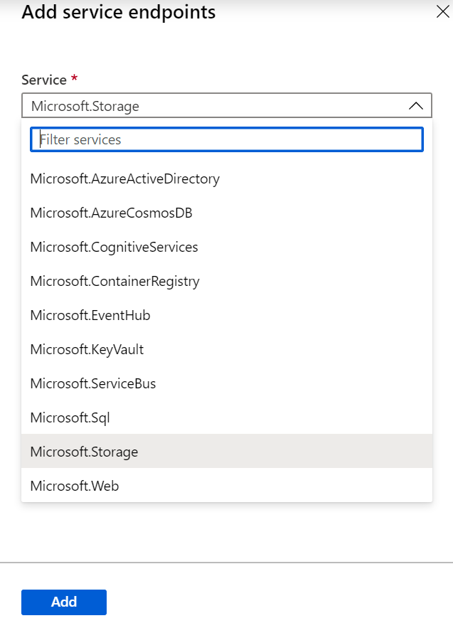
Add Service Endpoints to a subnet
There are many services that support endpoints
Adding service endpoints can take up to 15 minutes to complete
Notes:
Demo in your Azure portal – view subnet to add service endpoint
Configure service endpoints on a subnet in a virtual network. Endpoints work with any type of compute instances running within that subnet.
You can configure multiple service endpoints for all supported Azure services (Azure Storage or Azure SQL Database, for example) on a subnet.
For Azure SQL Database, virtual networks must be in the same region as the Azure service resource. If using GRS and RA-GRS Azure Storage accounts, the primary account must be in the same region as the virtual network. For all other services, you can secure Azure service resources to virtual networks in any region.
The virtual network where the endpoint is configured can be in the same or different subscription than the Azure service resource. For more information on permissions required for setting up endpoints and securing Azure services, see Provisioning.
For supported services, you can secure new or existing resources to virtual networks using service endpoints.

Slide 7
Demonstration - Create a Service Endpoint service
1
Create a virtual network with one subnet
2
Add a subnet and enable a service endpoint
3
Create an Azure resource and allow network access to it from only a subnet
4
Deploy a virtual machine (VM) to each subnet
5
Confirm access to a resource from a subnet
6
Confirm access is denied to a resource from a subnet and the internet
Notes:
Restrict access to PaaS resources - tutorial - Azure portal | Microsoft Docs
https://docs.microsoft.com/azure/virtual-network/tutorial-restrict-network-access-to-resources
Virtual network service endpoints enable you to limit network access to some Azure service resources to a virtual network subnet. You can also remove internet access to the resources. Service endpoints provide direct connection from your virtual network to supported Azure services, allowing you to use your virtual network's private address space to access the Azure services. Traffic destined to Azure resources through service endpoints always stays on the Microsoft Azure backbone network. In this tutorial, you learn how to:
Create a virtual network with one subnet
Add a subnet and enable a service endpoint
Create an Azure resource and allow network access to it from only a subnet
Deploy a virtual machine (VM) to each subnet
Confirm access to a resource from a subnet
Confirm access is denied to a resource from a subnet and the internet

Slide 8
Summary – Explain virtual network Service endpoints
Check your knowledge
Microsoft Learn Modules (docs.microsoft.com/Learn)
Azure virtual network service endpoints | Microsoft Docs

Slide 9
Lesson 02: Define Private Link Services and Private Endpoints

Slide 10
Define Private Link Services and Private Endpoints overview
What is Azure Private Link?
What is Azure Private endpoint?
What is Azure private Link service?
Private Link service workflow
Private endpoint properties
Demonstration
Review

Slide 11
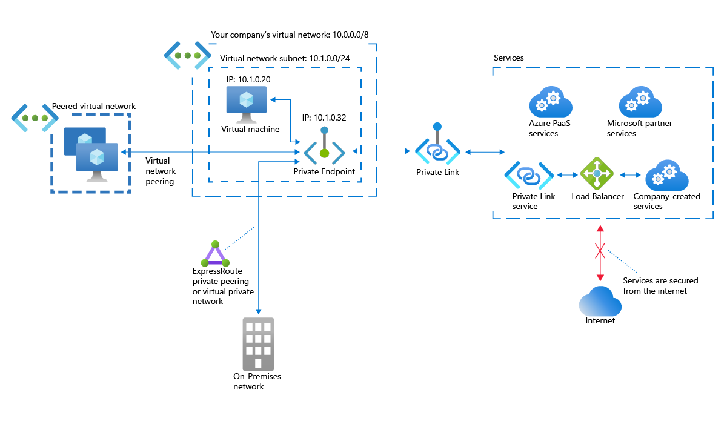
What is Azure Private Link ?
Integration with on-premises and peered networks
In the event of a security incident within your network, only the mapped resource would be accessible
Private connectivity to services on Azure. Traffic remains on the Microsoft network, with no public internet access
Notes:
Private Link Documentation - https://docs.microsoft.com/Azure/private-link/
Azure Private Link provides the following benefits:
Privately access services on the Azure platform: Connect your virtual network to services in Azure without a public IP address at the source or destination. Service providers can render their services in their own virtual network and consumers can access those services in their local virtual network. The Private Link platform will handle the connectivity between the consumer and services over the Azure backbone network.
On-premises and peered networks: Access services running in Azure from on-premises over ExpressRoute private peering, VPN tunnels, and peered virtual networks using private endpoints. There's no need to configure ExpressRoute Microsoft peering or traverse the internet to reach the service. Private Link provides a secure way to migrate workloads to Azure.
Protection against data leakage: A private endpoint is mapped to an instance of a PaaS resource instead of the entire service. Consumers can only connect to the specific resource. Access to any other resource in the service is blocked. This mechanism provides protection against data leakage risks.
Global reach: Connect privately to services running in other regions. The consumer's virtual network could be in region A and it can connect to services behind Private Link in region B.
Extend to your own services: Enable the same experience and functionality to render your service privately to consumers in Azure. By placing your service behind a standard Azure Load Balancer, you can enable it for Private Link. The consumer can then connect directly to your service using a private endpoint in their own virtual network. You can manage the connection requests using an approval call flow. Azure Private Link works for consumers and services belonging to different Azure Active Directory tenants.

Slide 12
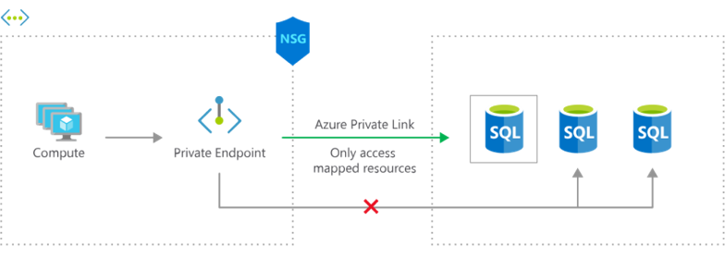
What is Azure Private Endpoint ?
The Azure resource becomes, in a sense, a part of your virtual network.
The connection to the resource now uses the Microsoft Azure backbone network instead of the public internet
Configure the Azure resource to no longer expose its public IP address, which eliminates that potential security risk.
Notes:
Private Endpoint is the key technology behind Private Link. Private Endpoint is a network interface that enables a private and secure connection between your virtual network and an Azure service. In other words, Private Endpoint is the network interface that replaces the resource's public endpoint.
Private Link provides secure access to Azure services. Private Link achieves that security by replacing a resource's public endpoint with a private network interface. Private Endpoint uses a private IP address from the VNet to bring the service into the VNet.
There are three key points to consider with this new architecture:
The Azure resource becomes, in a sense, a part of your virtual network.
The connection to the resource now uses the Microsoft Azure backbone network instead of the public internet.
You can configure the Azure resource to no longer expose its public IP address, which eliminates that potential security risk
Another diagram to show private endpoint: https://docs.microsoft.com/azure/virtual-network/vnet-integration-for-azure-services#private-link-and-private-endpoints

Slide 13
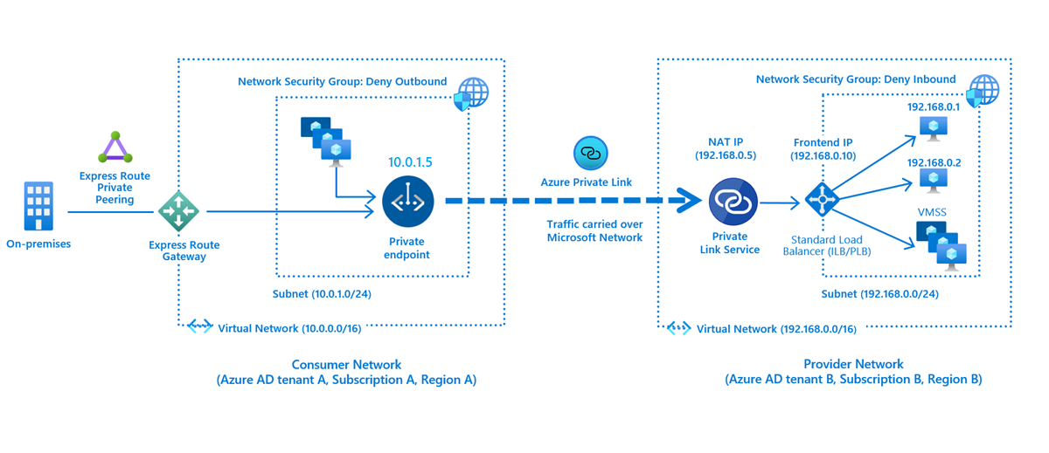
What is Azure Private Link service?
Notes:
Azure Private Link service is the reference to your own service that is powered by Azure Private Link. Your service that is running behind Azure standard load balancer can be enabled for Private Link access so that consumers to your service can access it privately from their own VNets. Your customers can create a private endpoint inside their VNet and map it to this service. A Private Link service receives connections from multiple private endpoints. A private endpoint connects to one Private Link service.

Slide 14
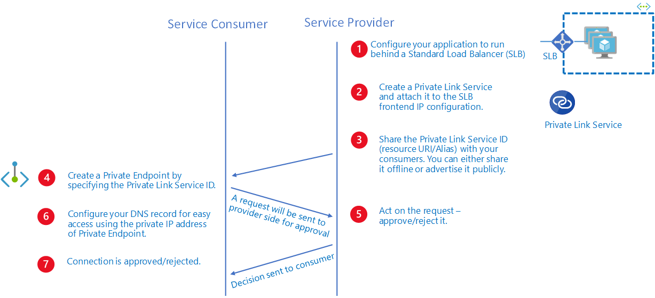
Private Link service workflow
Notes:
What is Azure Private Link service? | Microsoft Docs

Slide 15
Private Endpoint properties
Property | Description
Name | A unique name within the resource group.
Subnet | The subnet to deploy and allocate private IP addresses from a virtual network
Private Link Resource | The private link resource to connect using resource ID or alias, from the list of available types. A unique network identifier will be generated for all traffic sent to this resource.
Target subresource | The subresource to connect. Each private link resource type has different options to select based on preference.
Connection approval method | Automatic or manual. Based on Azure role-based access control (Azure RBAC) permissions, your private endpoint can be approved automatically. If you try to connect to a private link resource without Azure RBAC, use the manual method to allow the owner of the resource to approve the connection.
Request Message | You can specify a message for requested connections to be approved manually. This message can be used to identify a specific request.
Connection status | A read-only property that specifies if the private endpoint is active. Only private endpoints in an approved state can be used to send traffic. Additional states available: Approved: Connection was automatically or manually approved and is ready to be used. Pending: Connection was created manually and is pending approval by the private link resource owner. Rejected: Connection was rejected by the private link resource owner. Disconnected: Connection was removed by the private link resource owner. The private endpoint becomes informative and should be deleted for cleanup.
Notes:
Before creating a Private Endpoint, you should consider the Private Endpoint properties and collect data about specific needs to be addressed. These include:
A unique name with a resource group
A subnet to deploy and allocate private IP addresses from a virtual network
The Private Link resource to connect using resource ID or alias, from the list of available types. A unique network identifier will be generated for all traffic sent to this resource.
The sub resource to connect. Each Private Link resource type has different options to select based on preference.
An automatic or manual connection approval method. Based on Azure role-based access control (Azure RBAC) permissions, your Private Endpoint can be approved automatically. If you try to connect to a Private Link resource without Azure RBAC, use the manual method to allow the owner of the resource to approve the connection.
A specific request message for requested connections to be approved manually. This message can be used to identify a specific request.
Connection status, A read-only property that specifies if the Private Endpoint is active. Only Private Endpoints in an approved state can be used to send traffic.

Slide 16
Demonstration – Create a Private Link service by using the Azure portal
Create a Private Link service that refers to your service
Give Private Link access to your service or resource deployed behind an Azure Standard Load Balancer
Users of your service have private access from their virtual network
Notes:
Quickstart - Create a Private Link service by using the Azure portal | Microsoft Docs
https://docs.microsoft.com/azure/private-link/create-private-link-service-portal
Additional demos: Private endpoint
Quickstart - Create a Private Endpoint using the Azure portal | Microsoft Docs
https://docs.microsoft.com/azure/private-link/create-private-endpoint-portal

Slide 17
Summary – Private Link and Private Endpoint
Check your knowledge
Microsoft Learn Modules (docs.microsoft.com/Learn)
What is Azure Private Link? | Microsoft Docs
What is an Azure Private Endpoint? | Microsoft Docs
Notes:
https://docs.microsoft.com/Azure/private-link/private-link-overview
https://docs.microsoft.com/Azure/private-link/private-endpoint-overview

Slide 18
Lesson 03: Integrate Private Endpoint with DNS

Slide 19
Integrate Private endpoint with DNS overview
Azure Private Endpoint DNS configuration
Significance of IP address 168.63.129.16
Azure services Private DNS zone configuration examples
Virtual network workloads without custom DNS server
On-premises workloads using a DNS forwarder
Virtual network and on-premises workloads using a DNS forwarder
Review

Slide 20
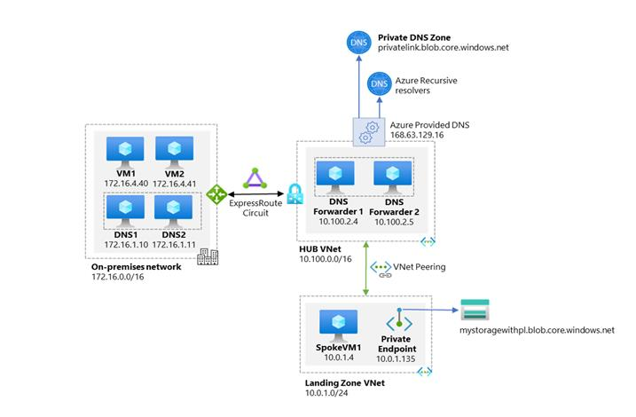
Azure Private Endpoint DNS configuration
High-level architecture for enterprise environments with central DNS resolution and where name resolution for Private Endpoint resources is done via Azure Private DNS
Notes:
Private DNS zones are typically hosted centrally in the same Azure subscription where the hub VNet is deployed. This central hosting practice is driven by cross-premises DNS name resolution and other needs for central DNS resolution such as Active Directory. In most cases, only networking/identity admins have permissions to manage DNS records in these zones.
Application teams do have permissions to create Azure resource in their own subscription. They do not have any permissions in the central networking connectivity subscription, which includes managing DNS records in the private DNS zones. This access limitation means they do not have the possibility to create the DNS records required when deploying Azure PaaS services with Private Endpoints.
The following diagram shows a typical high-level architecture for enterprise environments with central DNS resolution and where name resolution for Private Link resources is done via Azure Private DNS:
From the previous diagram, it is important to highlight that:
On-premises DNS servers have conditional forwarders configured for each Private Endpoint public DNS zone forwarder pointing to the DNS forwarders (10.100.2.4 and 10.100.2.5) hosted in the hub VNet.
The DNS servers 10.100.2.4 and 10.100.2.5 hosted in the hub VNet use the Azure-provided DNS resolver (168.63.129.16) as a forwarder.
All Azure VNets have the DNS forwarders (10.100.2.4 and 10.100.2.5) configured as the primary and secondary DNS servers.
There are two conditions that must be true to allow application teams the freedom to create any required Azure PaaS resources in their subscription:
Central networking and/or central platform team must ensure that application teams can only deploy and access Azure PaaS services via Private Endpoints.
Central networking and/or central platform teams must ensure that whenever Private Endpoints are created, the corresponding records are automatically created in the centralized private DNS zone that matches the service created.
DNS record needs to follow the lifecycle of the Private Endpoint and automatically remove the DNS record when the Private Endpoint is deleted.

Slide 21
Significance of IP address 168.63.129.16
Enables the VM Agent to communicate with the Azure platform to signal that it is in a "Ready" state
Enables communication with the DNS virtual server to provide filtered name resolution to the resources (such as VM) that do not have a custom DNS server.
Enables health probes from Azure load balancer to determine the health state of VMs
Enables the VM to obtain a dynamic IP address from the DHCP service in Azure
Enables Guest Agent heartbeat messages for the PaaS role
Notes:
This IP is not accessible from on prem networks
IP address 168.63.129.16 is a virtual public IP address that is used to facilitate a communication channel to Azure platform resources. Customers can define any address space for their private virtual network in Azure. The Azure platform resources must be presented as a unique public IP address. This virtual public IP address facilitates the following things:
Enables the VM Agent to communicate with the Azure platform to signal that it is in a "Ready" state
Enables communication with the DNS virtual server to provide filtered name resolution to the resources (such as VM) that do not have a custom DNS server. This filtering makes sure that customers can resolve only the hostnames of their resources
Enables health probes from Azure load balancer to determine the health state of VMs
Enables the VM to obtain a dynamic IP address from the DHCP service in Azure
Enables Guest Agent heartbeat messages for the PaaS role
In a non-virtual network scenario (Classic), a private IP address is used instead of 168.63.129.16. This private IP address is dynamically discovered through DHCP. Firewall rules specific to 168.63.129.16 need to be adjusted as appropriate.

Slide 22
Azure services Private DNS zone configuration examples
Private Link resource type / Subresource | Private DNS zone name
Azure Automation / (Microsoft.Automation/automationAccounts) / Webhook, DSCAndHybridWorker | privatelink.Azure-automation.net
Azure SQL Database (Microsoft.Sql/servers) / sqlServer | privatelink.database.windows.net
Azure Synapse Analytics (Microsoft.Sql/servers) / sqlServer | privatelink.database.windows.net
Azure Synapse Analytics (Microsoft.Synapse/workspaces) / Sql | privatelink.sql.Azuresynapse.net
Storage account (Microsoft.Storage/storageAccounts) / Blob (blob, blob_secondary) | privatelink.[Service].core.windows.net
Notes:
privatelink.[Service].core.windows.net – [add any service ]
Azure creates a canonical name DNS record (CNAME) on the public DNS. The CNAME record redirects the resolution to the private domain name. You can override the resolution with the private IP address of your Private Endpoints.
Your applications don't need to change the connection URL. When resolving to a public DNS service, the DNS server will resolve to your Private Endpoints. The process doesn't affect your existing applications.
Private networks already using the private DNS zone for a given type, can only connect to public resources if they don't have any Private Endpoint connections, otherwise a corresponding DNS configuration is required on the private DNS zone in order to complete the DNS resolution sequence.

Slide 23
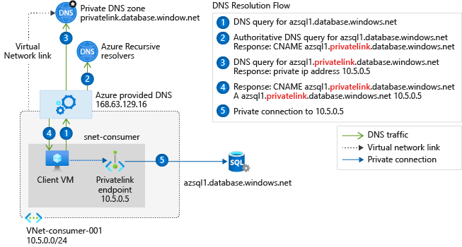
Virtual network workloads without custom DNS server
Notes:
Azure Private Endpoint DNS configuration | Microsoft Docs
This configuration is appropriate for virtual network workloads without a custom DNS server. In this scenario, the client queries for the Private Endpoint IP address to the Azure-provided DNS service 168.63.129.16. Azure DNS will be responsible for DNS resolution of the private DNS zones.
This scenario uses the Azure SQL Database-recommended private DNS zone. For other services, you can adjust the model using the following reference: Azure services DNS zone configuration.
To configure properly, you need the following resources:
Client virtual network
Private DNS zone privatelink.database.windows.net with type A record
Private Endpoint information (FQDN record name and private IP address)
The following screenshot illustrates the DNS resolution sequence from virtual network workloads using the private DNS zone:

Slide 24
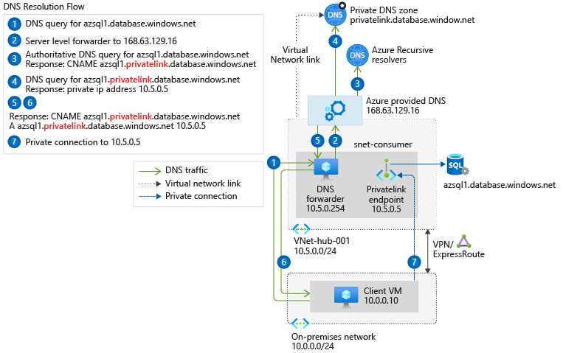
On-premises workloads using a DNS forwarder
Notes:
Azure Private Endpoint DNS configuration | Microsoft Docs
For on-premises workloads to resolve the FQDN of a Private Endpoint, use a DNS forwarder to resolve the Azure service public DNS zone in Azure. A DNS forwarder is a Virtual Machine running on the Virtual Network linked to the Private DNS Zone that can proxy DNS queries coming from other Virtual Networks or from on-premises. This is required as the query must be originated from the Virtual Network to Azure DNS. A few options for DNS proxies are: Windows running DNS services, Linux running DNS services, Azure Firewall.
The following scenario is for an on-premises network that has a DNS forwarder in Azure. This forwarder resolves DNS queries via a server-level forwarder to the Azure provided DNS 168.63.129.16.
This scenario uses the Azure SQL Database-recommended private DNS zone. For other services, you can adjust the model using the following reference: Azure services DNS zone configuration.
To configure properly, you need the following resources:
On-premises network
Virtual network connected to on-premises
DNS forwarder deployed in Azure
Private DNS zones privatelink.database.windows.net with type A record
Private Endpoint information (FQDN record name and private IP address)
The following diagram illustrates the DNS resolution sequence from an on-premises network. The configuration uses a DNS forwarder deployed in Azure. The resolution is made by a private DNS zone linked to a virtual network:

Slide 25
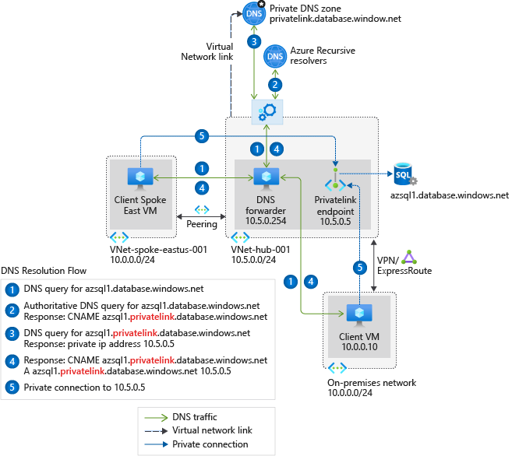
Virtual network and on-premises workloads using a DNS forwarder
Notes:
Azure Private Endpoint DNS configuration | Microsoft Docs
For workloads accessing a Private Endpoint from virtual and on-premises networks, use a DNS forwarder to resolve the Azure service public DNS zone deployed in Azure.
The following scenario is for an on-premises network with virtual networks in Azure. Both networks access the Private Endpoint located in a shared hub network.
This DNS forwarder is responsible for resolving all the DNS queries via a server-level forwarder to the Azure-provided DNS service 168.63.129.16.
A single private DNS zone is required for this configuration. All client connections made from on-premises and peered virtual networks must also use the same private DNS zone.
This scenario uses the Azure SQL Database-recommended private DNS zone. For other services, you can adjust the model using the following reference: Azure services DNS zone configuration.
To configure properly, you need the following resources:
On-premises network
Virtual network connected to on-premises
Peered virtual network
DNS forwarder deployed in Azure
Private DNS zones privatelink.database.windows.net with type A record
Private Endpoint information (FQDN record name and private IP address)
The following diagram shows the DNS resolution for both networks, on-premises and virtual networks. The resolution is using a DNS forwarder. The resolution is made by a private DNS zone linked to a virtual network:

Slide 26
Summary – Integrate Private Endpoint with DNS
Check your knowledge
Microsoft Learn Modules (docs.microsoft.com/Learn)
Azure Private Endpoint DNS configuration | Microsoft Docs
Notes:
Learn - https://docs.microsoft.com/learn/browse/
Control and organize Azure resources with Azure Resource Manager - https://docs.microsoft.com/learn/modules/control-and-organize-with-Azure-resource-manager/
Describe core Azure architectural components - https://docs.microsoft.com/learn/modules/Azure-architecture-fundamentals/
References
What are Management Groups - https://docs.microsoft.com/Azure/governance/management-groups/overview
What is Azure Resource Manager - https://docs.microsoft.com/Azure/Azure-resource-manager/management/overview

Slide 27
Lesson 04: Exercise - Restrict network access to PaaS resources with virtual network service endpoints

Slide 28
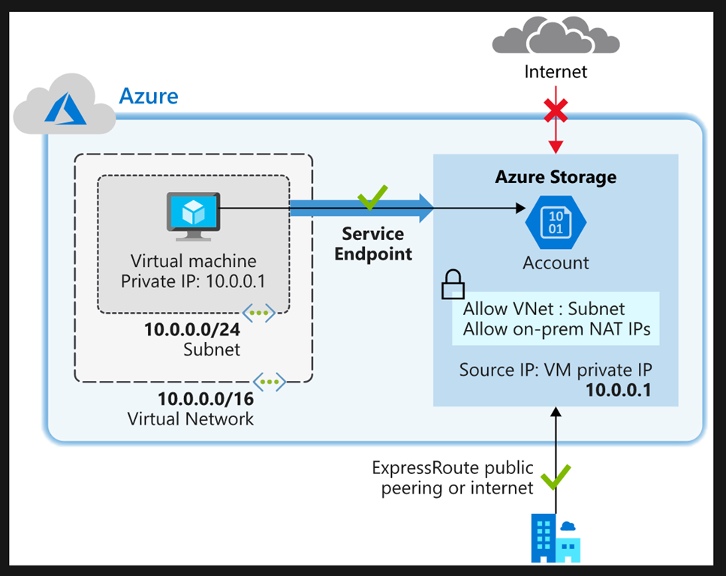
Restrict network access to PaaS resources with virtual network service endpoints
Task 1: Create a virtual network
Task 2: Enable a service endpoint
Task 3: Restrict network access for a subnet
Task 4: Add additional outbound rules
Task 5: Allow access for RDP connections
Task 6: Restrict network access to a resource
Task 7: Create a file share in the storage account
Task 8: Restrict network access to a subnet
Task 9: Create virtual machines
Task 10: Confirm access to storage account
Task 11: Clean up resources
Notes:
AZ-700-Designing-and-Implementing-Microsoft-Azure-Networking-Solutions (microsoftlearning.github.io)
https://microsoftlearning.github.io/AZ-700-Designing-and-Implementing-Microsoft-Azure-Networking-Solutions/

Slide 29
Summary – Restrict network access to PaaS resources with virtual network service endpoints using the Azure portal
Check your knowledge
Microsoft Learn Modules (docs.microsoft.com/Learn)
Azure virtual network service endpoints | Microsoft Docs

Slide 30
Lesson 05: Exercise - Create an Azure Private Endpoint using Azure PowerShell

Slide 31
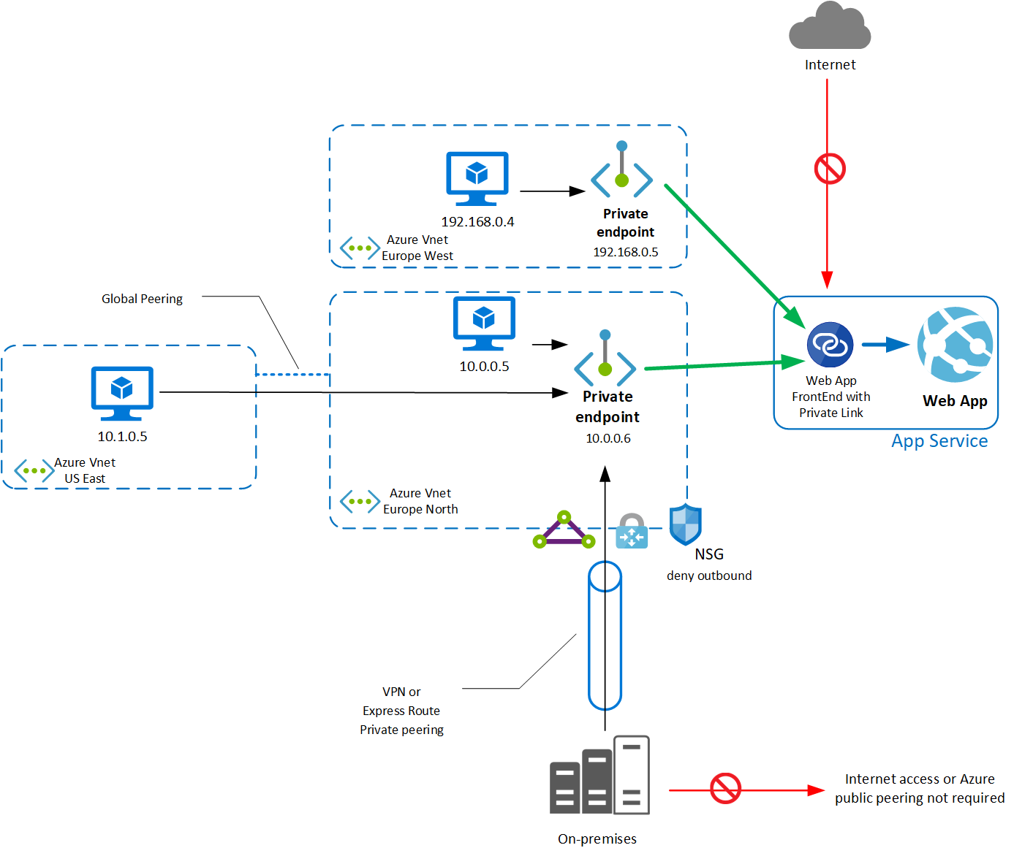
Exercise - Create an Azure Private Endpoint using Azure PowerShell
Task 1: Create a resource group
Task 2: Create a virtual network and bastion host
Task 3: Create a test virtual machine
Task 4: Create a Private Endpoint
Task 5: Configure the private DNS zone
Task 6: Test connectivity to the Private Endpoint
Task 7: Clean up resources
Notes:
https://microsoftlearning.github.io/AZ-700-Designing-and-Implementing-Microsoft-Azure-Networking-Solutions/
Task 1: Create a resource groupTask 2: Create a virtual network and bastion hostTask 3: Create a test virtual machineTask 4: Create a Private EndpointTask 5: Configure the private DNS zoneTask 6: Test connectivity to the Private EndpointTask 7: Clean up resources

Slide 32
Summary – Exercise - Create an Azure Private Endpoint using Azure PowerShell
Check your knowledge
Microsoft Learn Modules (docs.microsoft.com/Learn)
Quickstart - Create a Private Endpoint using the Azure portal | Microsoft Docs

Slide 33
Lesson 06: Integrate your app with an Azure Virtual Network
Notes:
Configure VNet integration for dedicated platform as a service (PaaS) services
• configure App Service for regional VNet integration
• configure Azure Kubernetes Service (AKS) for regional VNet integration
• configure clients to access App Service Environment

Slide 34
Integrate your app with an Azure Virtual Network overview
Virtual network integration options for Azure PaaS services
Configure App Service for regional VNET integration
Configure the virtual network for integration with App Service
Specify networking settings for application, including DNS and routing
Network options for Azure Kubernetes Service (AKS)
Review

Slide 35
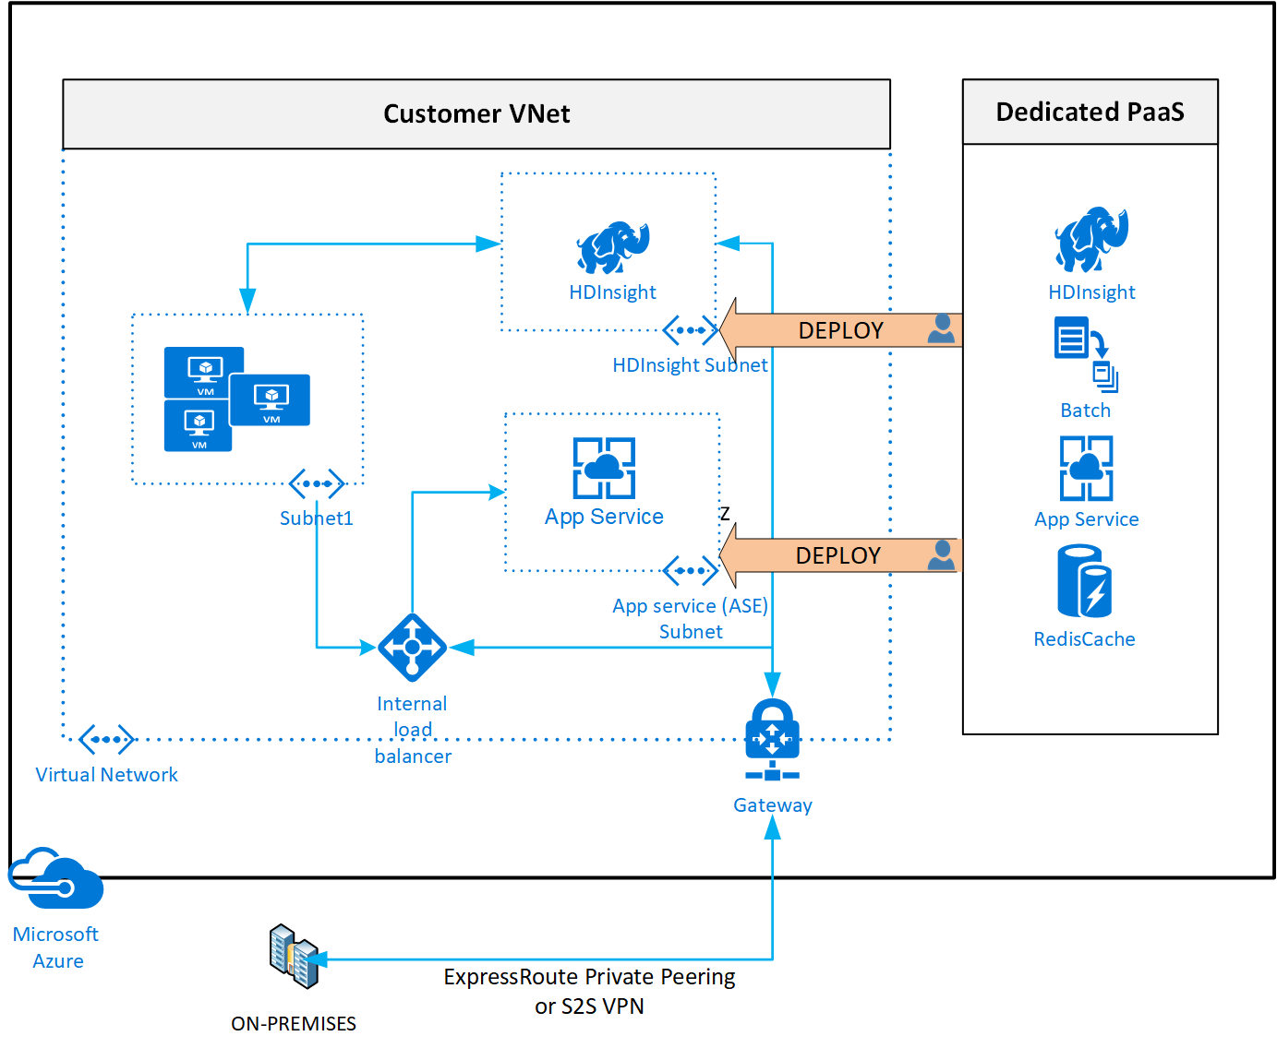
Virtual network integration options for Azure PaaS services
VNet Integration
Private Link
Public endpoints
Notes:
VNet Integration gives your app access to resources in your VNet, but it doesn't grant inbound private access to your app from the Vnet (subnet delegation )
Using Private Link to access a specific instance of the service from your virtual network and from on-premises networks.
Using public endpoints by extending a virtual network to the service, through Service Endpoints. Service Endpoints allow service resources to be secured to the virtual network.
Integrate app with Azure Virtual Network - Azure App Service | Microsoft Docs
Integrating Azure services to an Azure virtual network enables private access to the service from virtual machines or compute resources in the virtual network. You can integrate Azure services in your virtual network with the following options:
Deploying dedicated instances of the service into a virtual network. The services can then be privately accessed within the virtual network and from on-premises networks.
Using Private Link to access privately a specific instance of the service from your virtual network and from on-premises networks.
You can also access the service using public endpoints by extending a virtual network to the service, through Service Endpoints. Service Endpoints allow service resources to be secured to the virtual network.

Slide 36
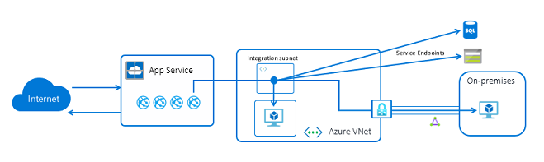
Configure App Service for regional VNet integration
VNet Integration gives your app access to resources in your VNet, but it doesn't grant inbound private access to your app from the VNet
Regional VNet Integration: When you connect to Azure Resource Manager virtual networks in the same region, you must have a dedicated subnet in the VNet you are integrating with.
Gateway-required VNet Integration: When you connect to VNet in other regions, you need an Azure Virtual Network gateway provisioned in the target VNet.
Notes:
With Azure Virtual Network (VNets), you can place many of your Azure resources in a non-internet-routable network. The VNet Integration feature enables your apps to access resources in or through a VNet. VNet Integration doesn't enable your apps to be accessed privately.
Azure App Service has two variations on the VNet Integration feature:
The multitenant systems that support the full range of pricing plans except Isolated.
The App Service Environment, which deploys into your VNet and supports Isolated pricing plan apps.
The VNet Integration feature is used in multitenant apps. If your app is in App Service Environment, then it's already in a VNet and doesn't require use of the VNet Integration feature to reach resources in the same VNet. For more information on all the networking features, see App Service networking features.
VNet Integration gives your app access to resources in your VNet, but it doesn't grant inbound private access to your app from the VNet. Private site access refers to making an app accessible only from a private network, such as from within an Azure virtual network. VNet Integration is used only to make outbound calls from your app into your VNet. The VNet Integration feature behaves differently when it's used with VNet in the same region and with VNet in other regions. The VNet Integration feature has two variations:
Regional VNet Integration: When you connect to Azure Resource Manager virtual networks in the same region, you must have a dedicated subnet in the VNet you are integrating with.
Gateway-required VNet Integration: When you connect to VNet in other regions or to a classic virtual network in the same region, you need an Azure Virtual Network gateway provisioned in the target VNet.
The VNet Integration features:
Require a Standard, Premium, PremiumV2, PremiumV3, or Elastic Premium pricing plan.
Support TCP and UDP.
Work with Azure App Service apps and function apps.
There are some things that VNet Integration does not support, like:
Mounting a drive.
Active Directory integration.
NetBIOS.

Slide 37
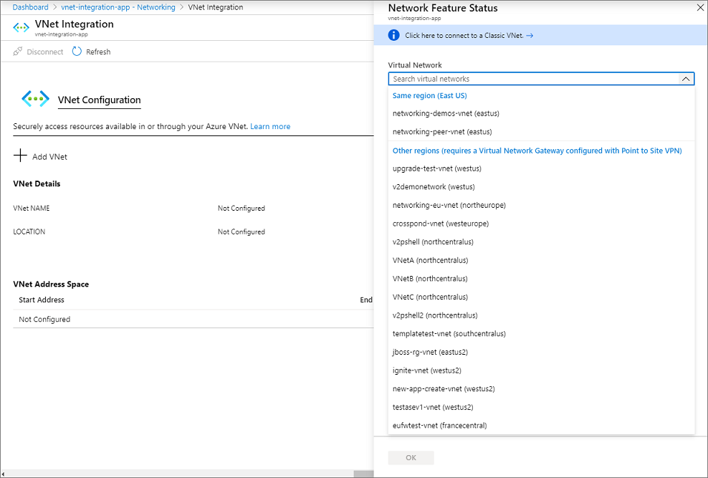
Configure the virtual network for integration with App Service
Go to the Networking UI in the App Service portal. Under VNet Integration, select Click here to configure
The drop-down list contains all of the Azure Resource Manager virtual networks in your subscription in the same region
Underneath that is a list of the Resource Manager virtual networks in all other regions. Select the VNet you want to integrate with..
Notes:
Demo will have app service with vnet integration
The drop-down list contains all of the Azure Resource Manager virtual networks in your subscription in the same region. Underneath that is a list of the Resource Manager virtual networks in all other regions. Select the VNet you want to integrate with.
If the VNet is in the same region, either create a new subnet or select an empty preexisting subnet.
To select a VNet in another region, you must have a VNet gateway provisioned with point to site enabled.
To integrate with a classic VNet, instead of selecting the Virtual Network drop-down list, select Click here to connect to a Classic VNet. Select the classic virtual network you want. The target VNet must already have a Virtual Network gateway provisioned with point-to-site enabled.
During the integration, your app is restarted. When integration is finished, you will see details on the VNet you're integrated with.

Slide 38
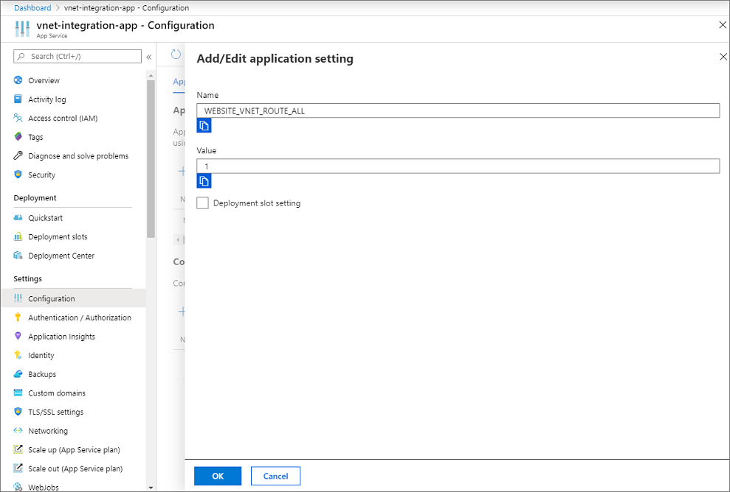
Associate the App Service with the virtual network
Resources in a VNet in the same region as your app
Resources in VNets peered to the VNet your app is integrated with
Service Endpoint secured services
Resources across Azure ExpressRoute connections
Resources in the VNet you are integrated with
Resources across peered connections, which include Azure ExpressRoute connections
Notes:
Using regional VNet Integration enables your app to access:
Resources in a VNet in the same region as your app.
Resources in VNets peered to the VNet your app is integrated with.
Service Endpoint secured services.
Resources across Azure ExpressRoute connections.
Resources in the VNet you are integrated with.
Resources across peered connections, which include Azure ExpressRoute connections.
Private Endpoints
When you use VNet Integration with VNets in the same region, you can use the following Azure networking features:
Network security groups (NSGs): You can block outbound traffic with an NSG that is placed on your integration subnet. The inbound rules do not apply because you can't use VNet Integration to provide inbound access to your app.
Route tables (UDRs): You can place a route table on the integration subnet to send outbound traffic where you want.

Slide 39
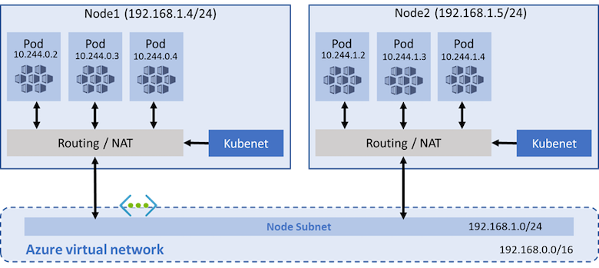
Network options for Azure Kubernetes Service (AKS)
Use kubenet when:
You have limited IP address space.
Most of the pod communication is within the cluster.
You don't need advanced AKS features such as virtual nodes or Azure Network Policy. Use Calico network policies.
Use Azure CNI when:
You have available IP address space.
Most of the pod communication is to resources outside of the cluster.
You don't want to manage user defined routes for pod connectivity.
You need AKS advanced features such as virtual nodes or Azure Network Policy. Use Calico network policies.
Notes:
• configure Azure Kubernetes Service (AKS) for regional VNet integration
By default, AKS clusters use kubenet, and an Azure virtual network and subnet are created for you. With kubenet, nodes get an IP address from the Azure virtual network subnet. Pods receive an IP address from a logically different address space to the Azure virtual network subnet of the nodes. Network address translation (NAT) is then configured so that the pods can reach resources on the Azure virtual network.
Prerequisites
The virtual network for the AKS cluster must allow outbound internet connectivity.
Don't create more than one AKS cluster in the same subnet.
AKS clusters may not use 169.254.0.0/16, 172.30.0.0/16, 172.31.0.0/16, or 192.0.2.0/24 for the Kubernetes service address range, pod address range or cluster virtual network address range.
The cluster identity used by the AKS cluster must have at least Network Contributor role on the subnet within your virtual network. You must also have the appropriate permissions, such as the subscription owner, to create a cluster identity and assign it permissions. If you wish to define a custom role instead of using the built-in Network Contributor role, the following permissions are required:
Microsoft.Network/virtualNetworks/subnets/join/action
Microsoft. Network/virtualNetworks/subnets/read

Slide 40
Summary – Integrate your App Service with Azure Virtual Networks
Check your knowledge
Microsoft Learn Modules (docs.microsoft.com/Learn)
Integrate app with Azure Virtual Network - Azure App Service | Microsoft Docs

Slide 41
End of presentation

